Slide 1
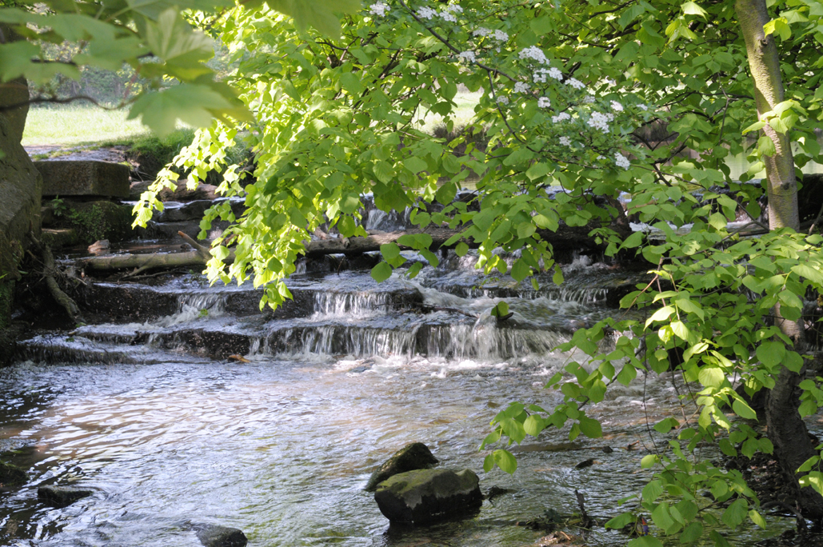

Leeds Parks & Green Spaces Forum
Tom Bliss
Academic Landscape Architect / Urban Designer
Producer / Director and Communications Consultant
Musician and songwriter

Slide 2
Leeds Parks and Green Spaces Forum
Established in 2012 by LCC as part of their Parks Strategy (about to expire, with new one being consulted upon). Independent of LCC but supported with staff time etc.
4 Meetings Per Year in venues around Leeds, preceded by a walk round the park/area. This introduces members to a sites they might not know and encourages productive networking
Number of Members – 99
Facebook Page members – 159
Facebook Group members – 160

Slide 3
Leeds Parks and Green Spaces Forum
Core Work
Sharing funding, training and other relevant opportunities
Providing networking opportunities, site visits and close links with Parks & Countryside Service
E-newsletter
Promoting value of green space to decision-makers

Slide 4
Leeds Parks and Green Spaces Forum
Talks at Meetings
Leeds’ Director of Public Health,
LCC’s Head of Environmental Services re plans for tree planting/woodland cover,
LCC’s Senior Project Manager tasked with drawing up the next Parks & Green Spaces Strategy, who held a consultation event.
Post-grad researchers from University of Leeds before launching their ‘Future of Leeds Parks’ exhibition and consultation.
Catherine Jones from Buglife about the importance of pollinators and other insects.
LCC’s dog-wardens, in answer to the perennial problem of dog mess
LCC’s Senior Planner re Green Space policies within housing/retail developments
Dr Cat Scott, Tom Bliss and Anna Gugan from UBoC on i-Tree and CCC targets
LCC’s Health Walks Initiative officer. A couple of groups then worked with them to develop a walk from or around their site

Slide 5

Leeds Parks Fund
Launched in 2017
Vehicle to collect donations from individuals/businesses, managed by Leeds Community Foundation
Aims
  To improve publicly accessible parks and green spaces in the city boundaries of Leeds - ‘Improvements’ defined by Green Flag criteria
Priorities
  To fulfil the aspiration for all 63 community parks in Leeds to meet the Green Flag criteria
  To ‘to create a city of opportunity for all’
  Projects led, or supported by, local communities
  Not a substitute for local authority funding – aims to add value
Notes:
To ‘improve the quality of life for our residents, particularly for those who are vulnerable or in poverty’ (Leeds Community Foundation aim) and ‘to create a city of opportunity for all’ (LCC, Best City Outcomes). So socially deprived areas, and those where there hasn’t been much recent investment in green space, will be prioritised.
University of Leeds residents survey in 2016 showed that the public’s priorities are:
Keep the park clean
Retain and improve facilities
Parks remaining free to enter
Community events and activities
Tackling anti-social behaviour and crime

Slide 6


Rethinking Parks
  Funding for 2 years
  Project aims to investigate the potential of charitable giving to parks
Will involve:-
Research
Developing and implementing fundraising and marketing plans
Engaging communities
Trialling new ways to donate
Making a difference on the ground
Notes:
In 2018 the partners received funding to invest in exploring the potential of charitable giving to parks through Leeds Parks Fund.
The funding comes from HLF through a scheme called ‘Rethinking Parks’ which is managed by innovation charity Nesta.
Leeds City Council were one of only 8 successful applicants for the high-profile fund.
The funded project will be launched publicly in Leeds in October 2018 and will involve:
Research by the University of Leeds into what local people and businesses think about the idea of charitable giving to public parks
The recruitment of a fundraising manager, and assistant, to develop and deliver a fundraising plan for Leeds Parks Fund
Working with communities to develop and promote the Fund
The production and implementation of a marketing plan to promote the benefit of parks, and the Leeds Parks Fund.
Trialling new ways to take charitable donations for parks e.g. text donations, site installations.
Setting up an independent panel to manage funds raised
Using funds raised to make a difference on the ground
Investigating the potential for other British Community Foundations to host similar funds.

Slide 7
Leeds Parks and Green Space Strategy
Work has started on 2020-30 strategy
Community engagement essential
Forum is a key partner in developing the strategy
Aim to be completed by end of 2020
Notes:
Emma presented plans for FPA project at the last meeting – we weren’t successful in getting the funding for the scheme, however, we will still embark upon developing our next Parks and Green Spaces Strategy shortly, and the themes we identified for the FPA project (partnerships, environment, health) will be key.
Community consultation and engagement will be an essential part of the process of developing the strategy and, as such, we would like the Forum to help us develop it from the earliest stages.
Emma will be leading on developing the strategy and will start in May, aiming to complete it by mid-2020.

Slide 8
Leeds Parks and Green Spaces Forum
Priorities for 2020
Leeds Parks and Green Space Strategy
Promoting the benefits of public green space for health and wellbeing (including clean air)
Promoting the importance of creating, maintaining and enhancing green corridors
Auditing Parks for accessibility with local partners

Slide 9
Leeds Parks and Green Spaces Forum
Website
http://leedsparksforum.org/
Our Chair, Lynda Kitching extends an invitation to 1 or 2 people to our next meeting on the afternoon of Thursday 23rd April, venue tba.

